Slide 1
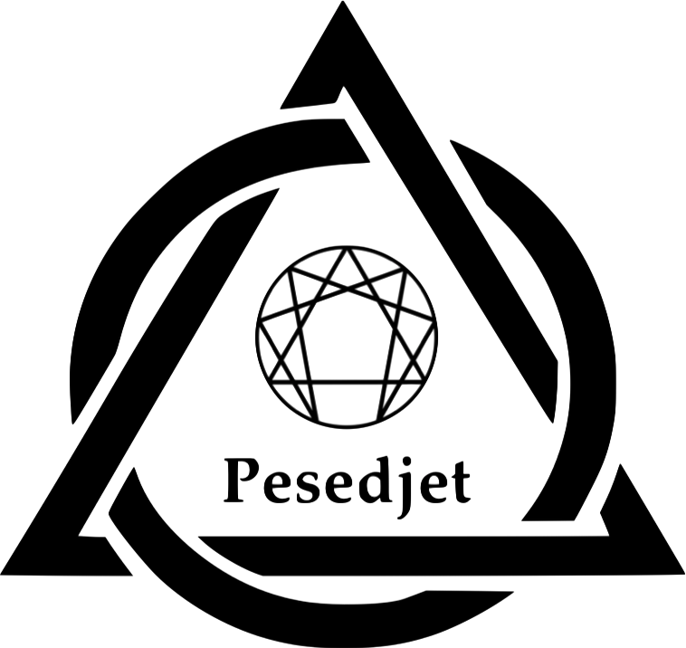
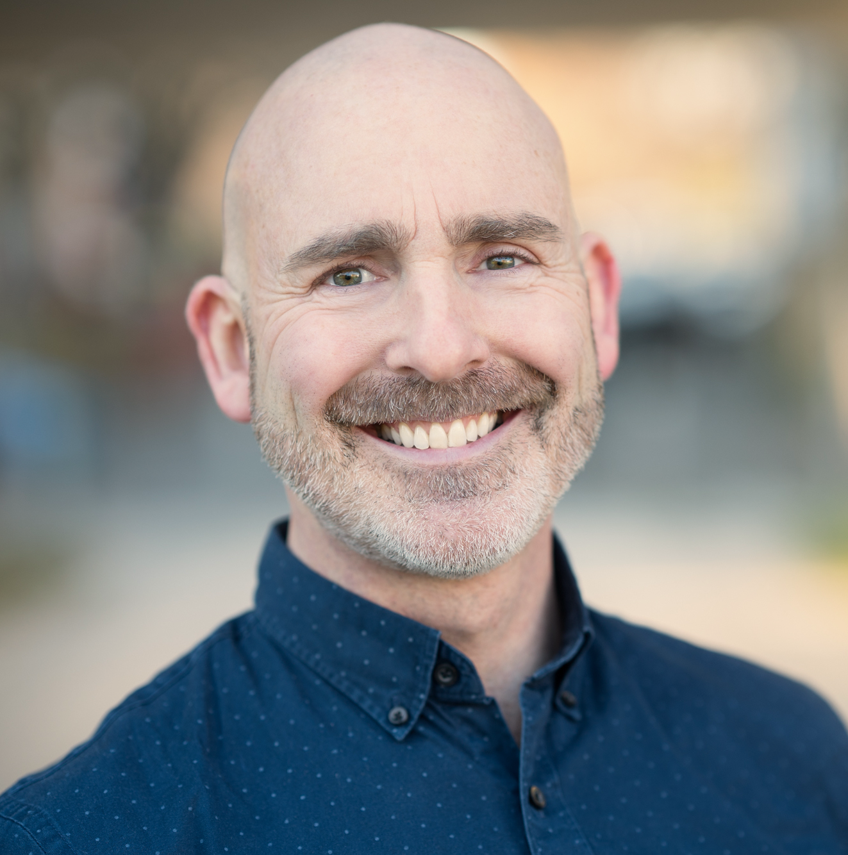
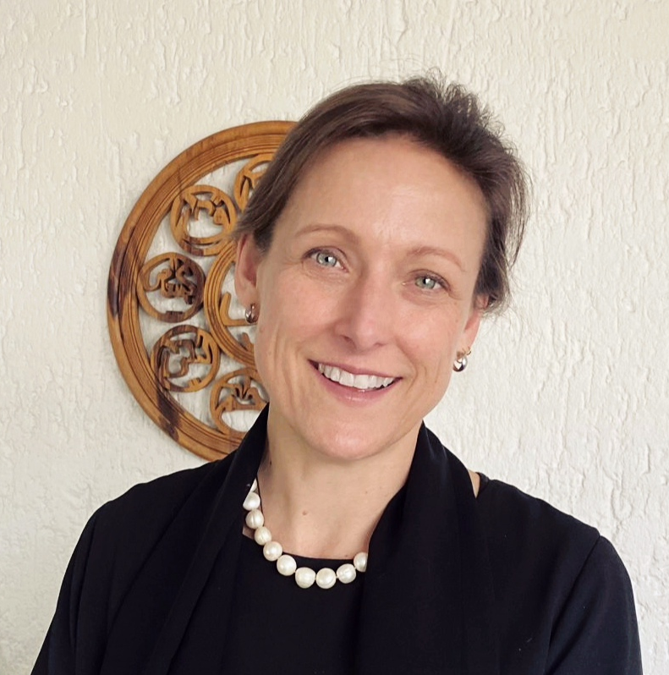
The Enneagram of True Voice
The Trauma-informed Enneagram Of
True Voice
Our Lost Voice
A NeuroAffective Relational understanding of the 9 Enneagram developmental pathways and how we forget our own voice.
Competing Inner Voices
Negotiations between the voices of our Inner Rebel, Critic, Protectors, Managers and Exiles.
The Whisper of a Deeper Truth.
Dissonance and Resolution
The Enneagram of the Antiself Actions.
Inner Dissonance and Self- Attunement.
True Voice
A higher resonance.
Eternal echoes in the hearts of friends.
The sound of the genuine in the circle of belonging.
Becoming Ma’a Kheru
True of Voice
Join us as we unveil our true selves so that together we can create the more beautiful world our hearts know is possible
Discover your power to act in service of the truth of Love.
Learn to Know Yourself in your Heart.
Experience the clarity of your own true awareness.
“Robert has changed my life […]
I will be forever grateful to him for allowing me to recognise that I must follow my heart’s path.” ~ Natasha K, Global Director
“Ingrid has vast, sound and profound Enneagram knowledge and application experience” - Lucille G. Enneagram Teacher and Consultant.
The Experience
Next-generation unification of the ancient and the modern: Egyptian wisdom meets the Cognitive Science of Embodiment and the latest evidence-based Trauma Healing insights and modalities.
Movement, consciousness-training practices, in-depth carpet-work and creative exercises alone and together.
Small group and top-class materials, AV & workbooks.
24 ICF CCEs and 48 IEA-ATP accreditation points.
3 DAYS LONDON 5 - 7 APRIL
4 DAYS TURIN 20 - 22 SEPTEMBER
Click here to book now
Need to chat to Ingrid or Rob about it?
robert@authenticlifecompany.com or https://ingrid-meeting-schedule.as.me/30Min

Slide 2
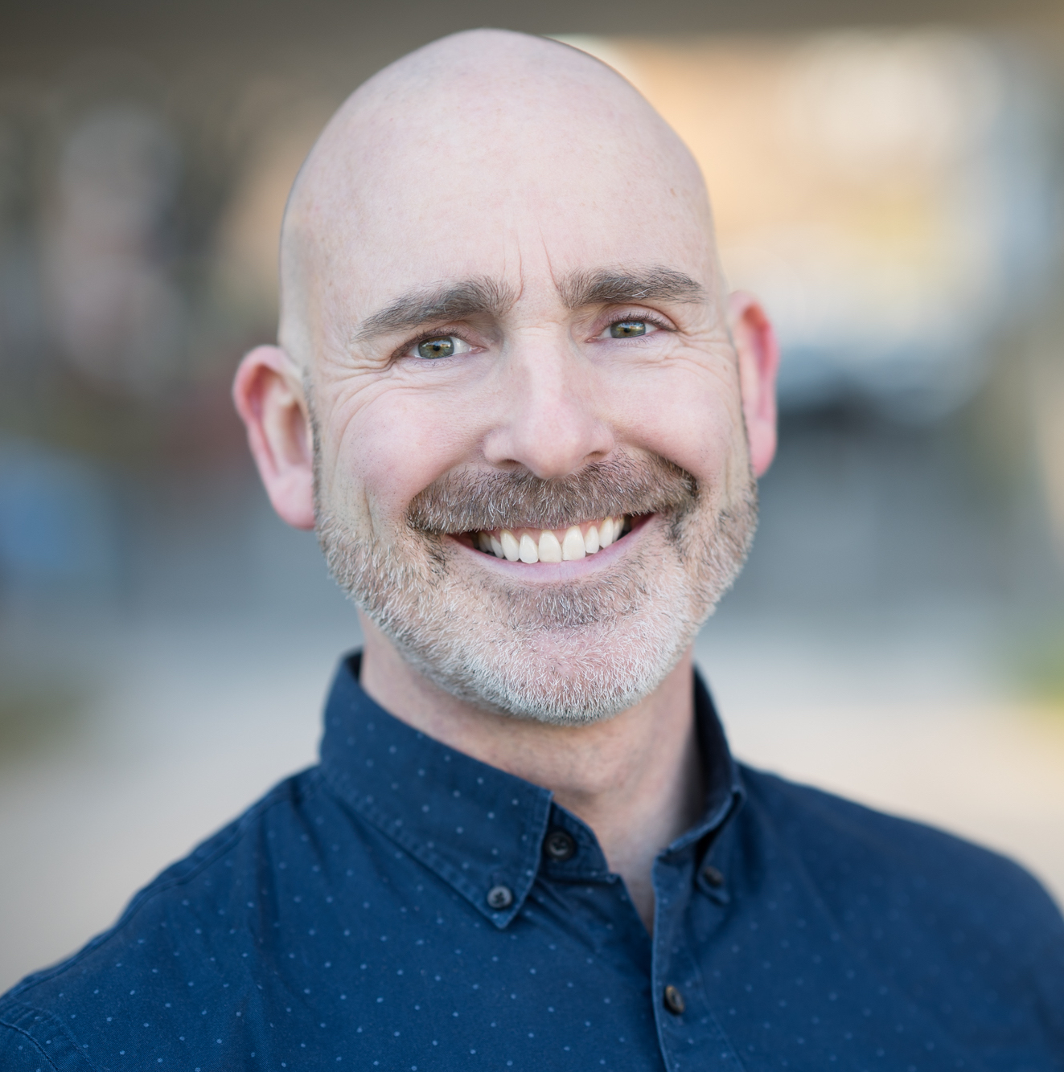
The Enneagram of True Voice
MODERN WIDSOM MEETS ANCIENT WISDOM
This programme’s foundations are built on the Science and Ethics of the The NeuroAffective Relational Model (NARM) a biopsychosocial approach to understanding personality development, trauma, healing and growth.
ANCIENT WISDOM
Applying perennial Ancient Egyptian Cosmology and Psychospiritual Technologies.
Hermetic, Kabbalistic and Sufi echoes of the ancient teachings
Discover the meaning of True Voice in the psychospiritual teachings of Ancient Egypt and in the wisdom traditions that followed.
Gain the ability to access and facilitate more adaptable self-expression and flow.
Work with the embodied emotional and unconscious instinctual drivers that underly the loss of True Voice using a Trauma-informed Enneagram that goes beyond typology.
Participate in embodied True of Voice practices, movement, and creative processes.
Gain Enneagram knowledge, wisdom and understanding along with contextually relevant application skills.
Experience safe and inclusive trauma-informed facilitation for a top-quality learning experience.
Join a post-programme specialist practitioner learning and collaboration community
“Through his enormous reservoir of Enneagram knowledge Robert has helped me to expand my capability as a coach and greatly supported my own personal growth.” - Andy Caldwell, Founder, CoCreate
RETREAT INVESTMENT:
Early bird rate until 5 March: $999 / £792
Standard Programme fee: $1062 / £846
Enquire about a limited number of partial bursaries for citizens of African countries.
Delegates will book their own accommodation at rates suited to their individual budgets and personal preferences. Mail us if you would like recommendations!
9
“Learning with Ingrid is a brilliant experience. She facilitates deep processes with a deft, light hand and a delightful sense of humour. She creates a safe and challenging learning space, and I have learnt so much about myself and enriched my work.” – Getti M. - Enneagram Coach
Becoming True of Voice equips helping professionals with the True of Voice understanding, presence and practices to recover their own True Voices in their lives and their work.
6
3

Slide 3
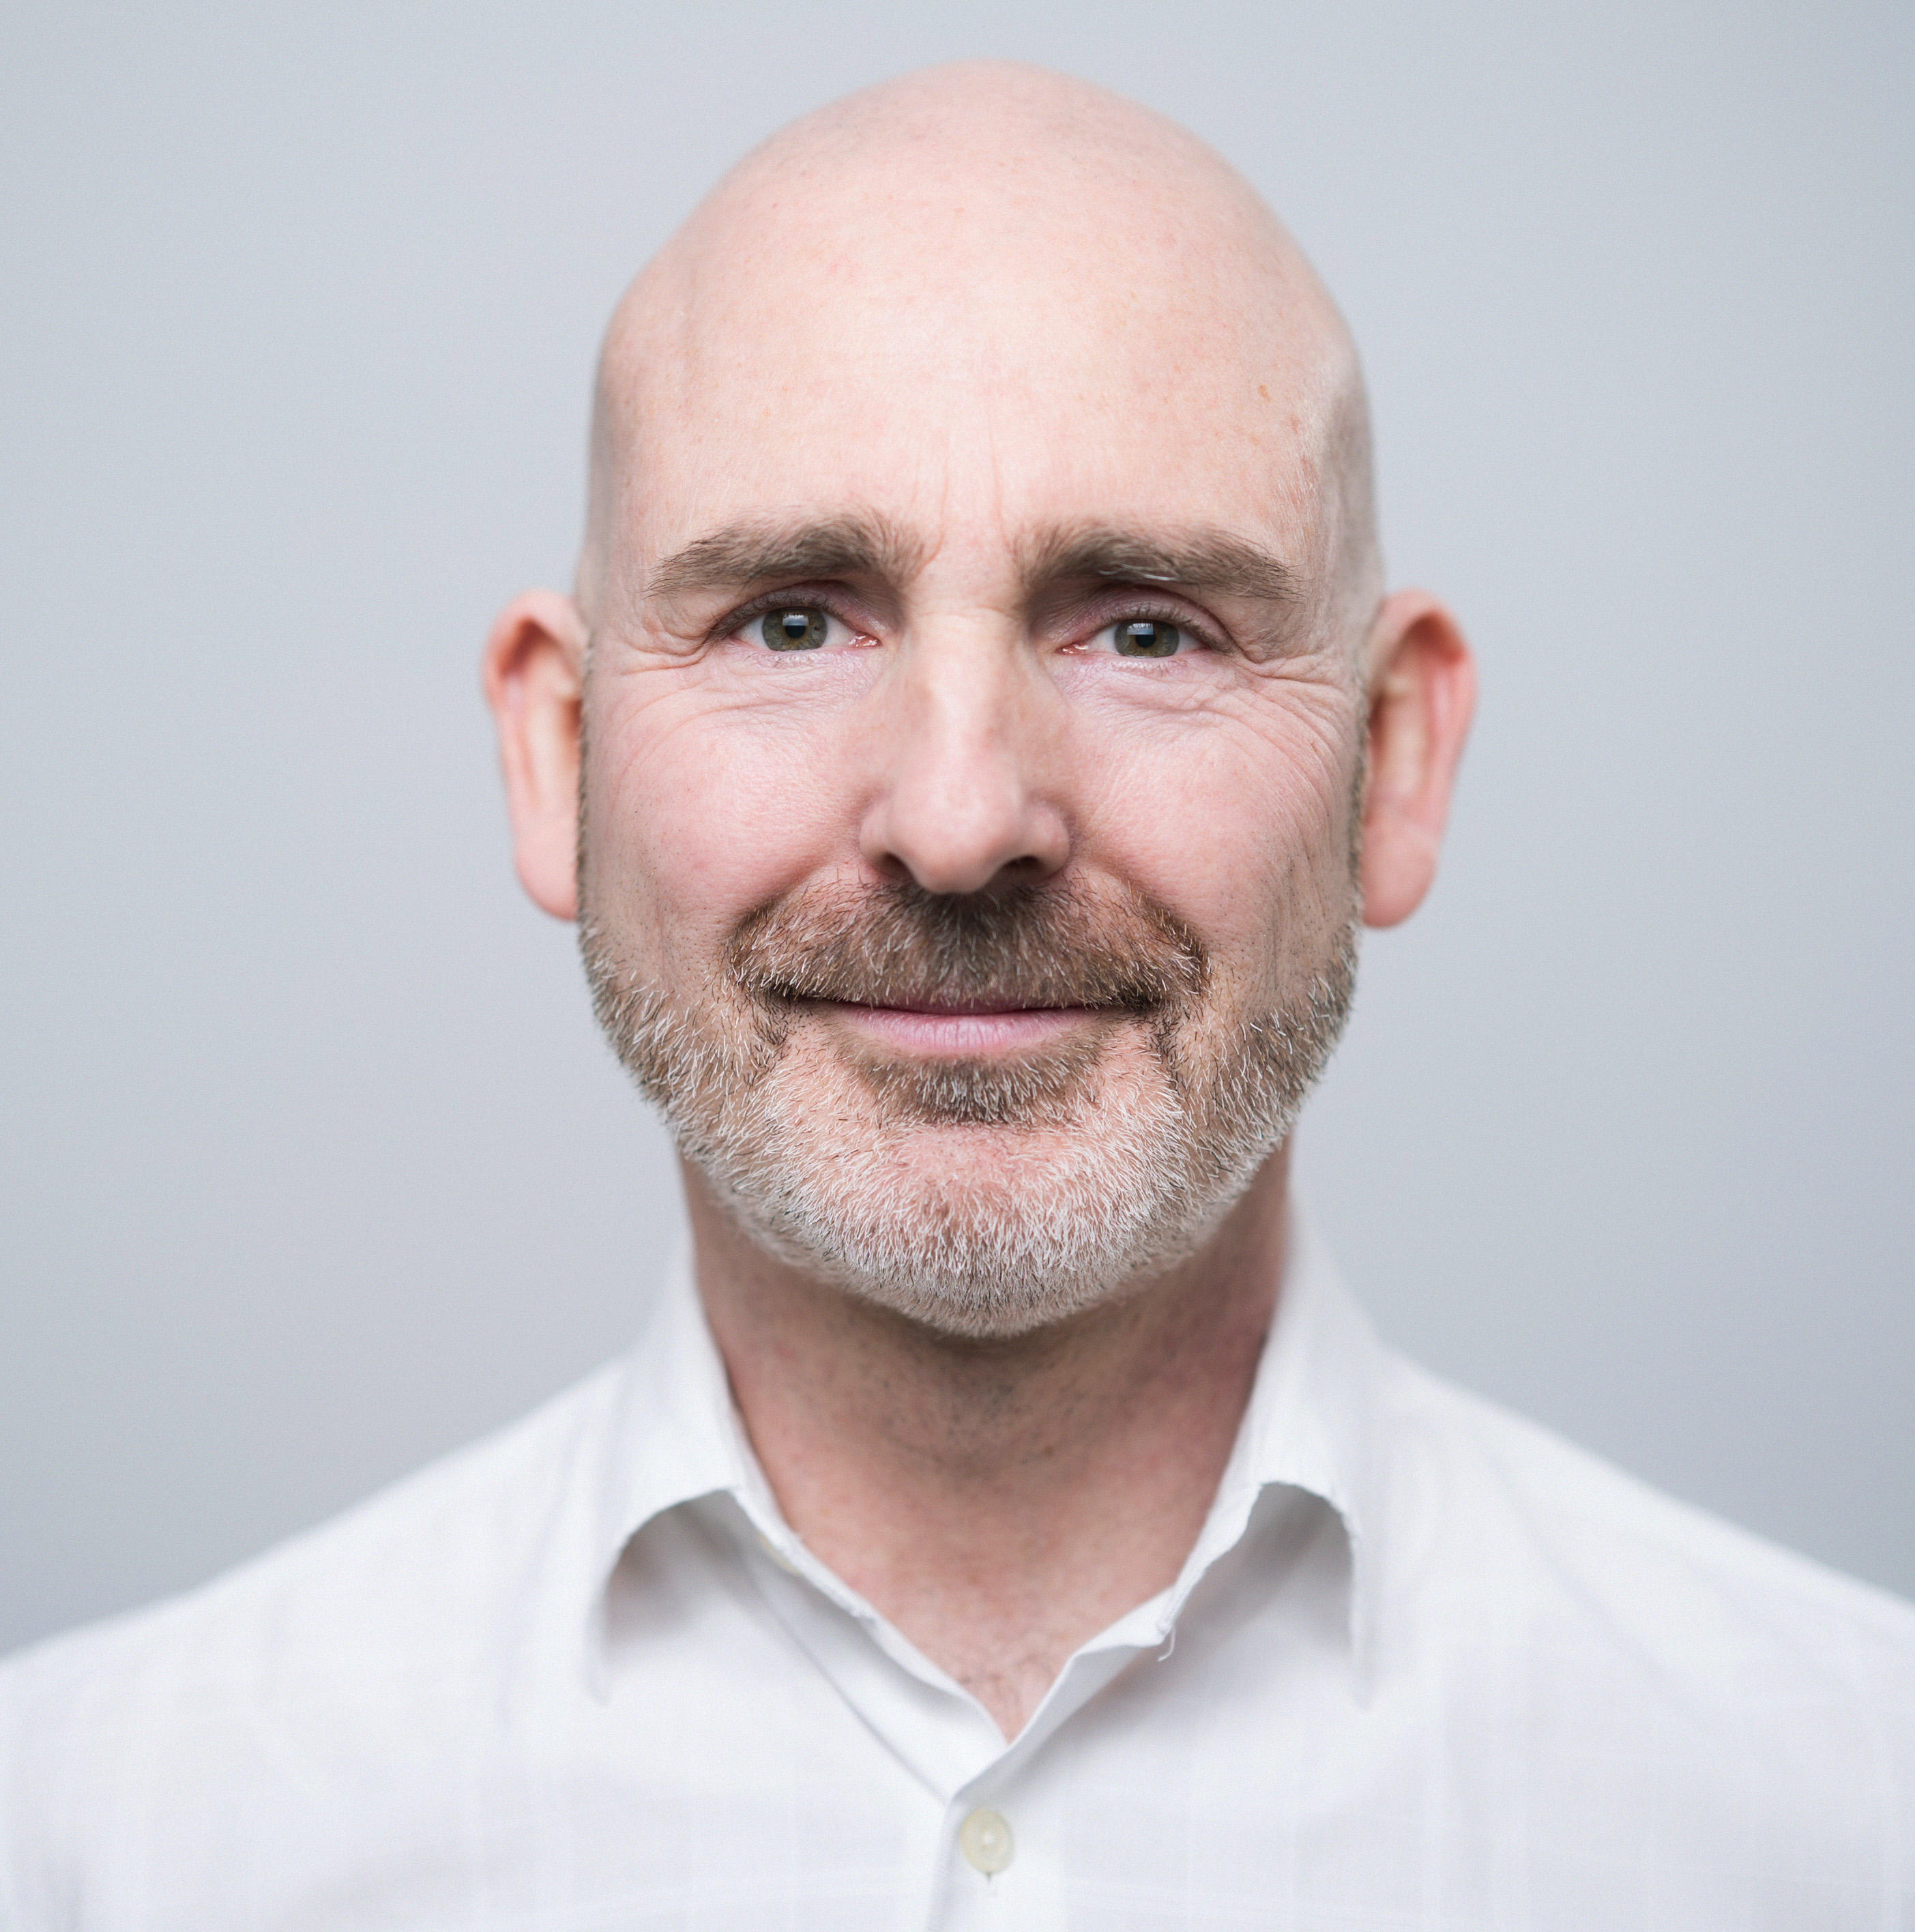
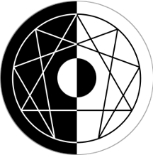
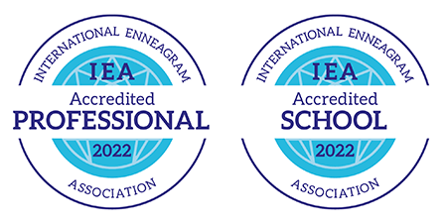
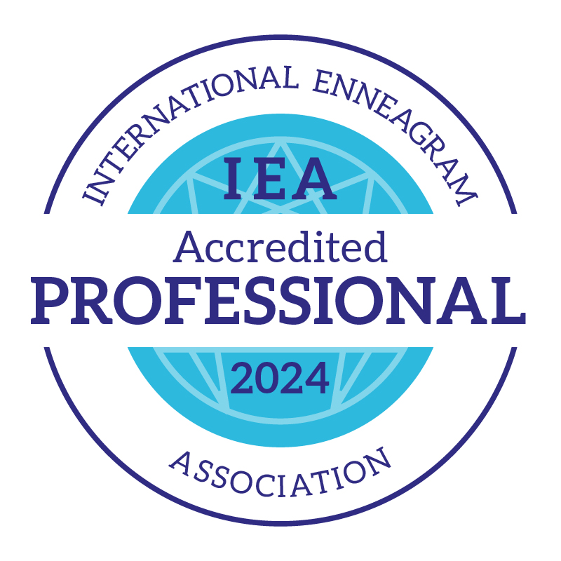
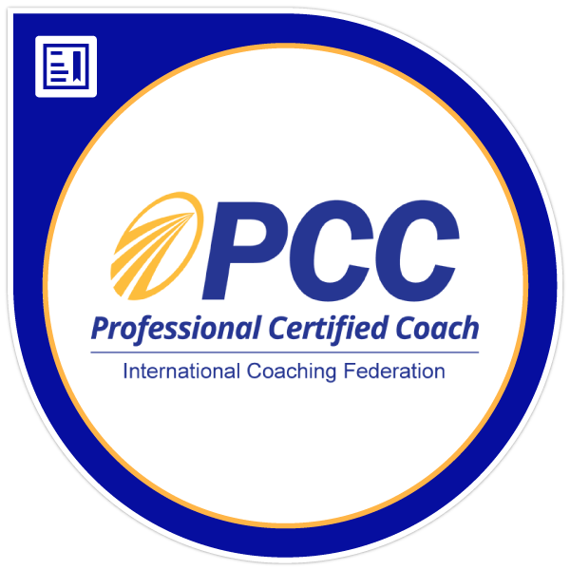
INGRID HURWITZ
“I love that you two are working together!” - Russ Hudson
Robert HUTCHINSON
CALLING AND BACKGROUND IEA-Certified Trauma-Informed Enneagram Coach Accreditation. Transformational Learning
I established Takdīr Transformation, now an IEA-Accredited School, in 2015. I take deep joy in my calling to develop helping professionals, coaches, Enneagram practitioners and spiritual leaders to use the Enneagram in profoundly transformational, trauma-informed ways that go far beyond typology.
In my past life I held roles such as Head of Leadership Development, Learning Wellness, Transformation and Sustainability in large corporates, with a golden thread of a focus on learning, change and growth.
I draw on a lifelong study of embodied psychospiritual transformation to facilitate real-time, experiential self-discovery that happens at many levels deeper than the intellect. Content and processes emerge from a synthesis of the secrets of ancient wisdom traditions with contemporary Cognitive Science and Traumatology research.
Takdīr programmes are described as “life-changing”. People also love the learning materials provided, and of course the amazing people who come on my courses because they are are drawn to this kind of deeper work.
CALLING AND BACKGROUND Enneagram-grounded Personal Development Executive Coaching Ancient Egyptian Metaphysics and Hermeticism
I am a transformational coach who helps clients to love living life by decoding their personality 'operating system’ to find their True Voice.
As Founder of the Authentic Life Company, I have been instrumental in guiding people from all over the world towards discovering their personal truth as the keystone to establishing success, as they experience and define it, in leadership, career and life.
My mission is to partner with people to help them develop a genuine, emotionally connected and purposeful mode of being human that integrates meaningful life and purposeful work.
I am an International Enneagram Association Accredited Professional, a Professional Certified Coach (PCC) with the International Coach Federation, an Accredited Practitioner of the iEQ9 Integrative Enneagram, and a Fellow of the Royal Society of Arts, a London-based global network of change-makers enabling people, places and the planet to flourish in harmony.
I am a lifelong student of Ancient Egyptian Cosmology and Spiritual Technologies.
TAKDĪR TRANSFORMATION (IES) www.takdir.co.za
PESEDJET The True Nature of the Enneagram
“We do not think our way into new ways of living. We live ourselves into new ways of thinking”
Tr. “I know myself in my heart.”
Email: ingrid@takdir.co.za Web: www.takdir.co.za
Email: robert@authenticlifecompany.com Web: www.authenticlifecompany.com
©️ TAKDĪR TRANSFORMATION. Pty (Ltd). 2015 / 139 769 / 07.

